Slide 1
Why football should be removed from the school system.

Slide 2
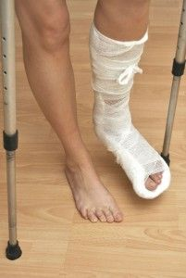
Injuries

Slide 3
Alternative sports

Slide 4
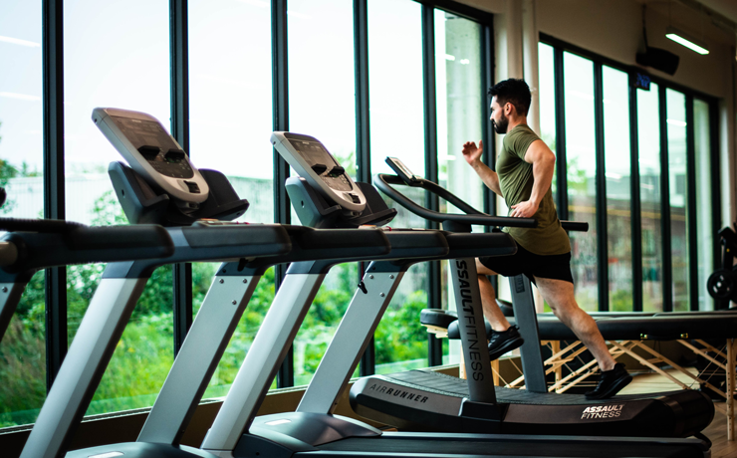
Alternative PE

